Slide 1
Complementary and Integrative Medicine
Kenneth Brummel-Smith, MD
Charlotte Edwards Maguire Professor of Geriatrics
Florida State University College of Medicine

Slide 2
Definitions
Complimentary medicine
Medical and health care systems, practices, and products that originated outside of mainstream medicine
Integrative medicine
When complimentary approaches are used in concert with mainstream medicine
Holistic medicine
Same as Integrative Medicine
Notes:
Complimentary - acupuncture, spinal manipulation, and massage therapy and natural products (such as herbs, probiotics, and fish oil

Slide 3
More Definitions
Functional medicine
Incorporates the latest in genetic science, systems biology, and understanding of how environmental and lifestyle factors influence the emergence and progression of disease.
Alternative medicine
The use of a non-mainstream approach in place of conventional medicine.

Slide 4
Problems with Definitions
Nutrition?
Western vs. non-western medicine?
“Traditional” medicine
Concept of “evidence”
Role of intuition?

Slide 5
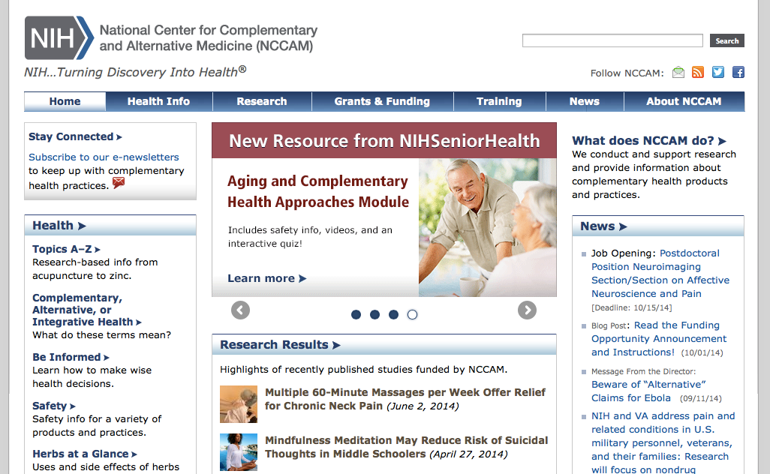

Slide 7
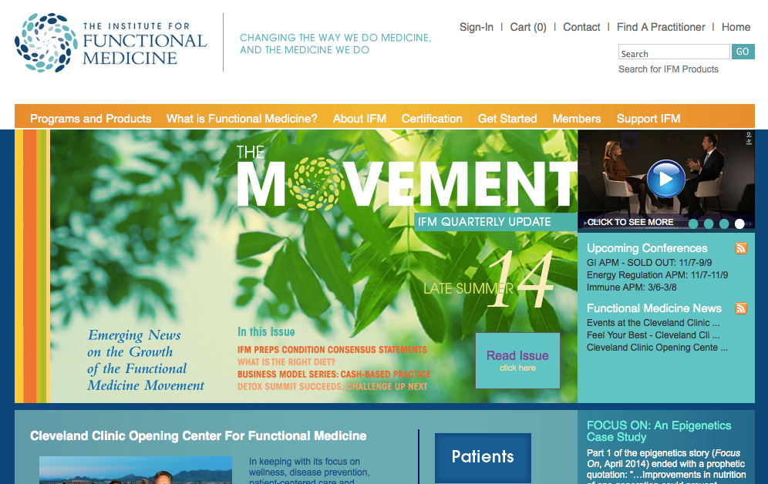

Slide 8
Local Resources
Healing Arts Alliance
http://www.healingartsalliance.org
TMH Family Medicine Residency
Integrative medicine clinic
Archbold Hospital (Thomasville)
Integrative Medicine Center

Slide 9
My Philosophy
Medical Choices, Medical Chances
Objective reality – statistical probabilities
Subjective reality – degrees of belief
Personal benefit from chiropractors, massage therapists, HeartMath, “Wellness Formula”
Medicine is not a science
It is an art that uses science to inform it
Surgery is not science either, it’s a craft
“Evidence when available, common sense when not”

Slide 10
Acupuncture
May help: tension headache, migraine, soft tissue injuries (sprains), osteoarthritis, sciatica, low back pain, neuropathies, post-operative nausea, chronic pain, stress
Does not help: rheumatoid arthritis, depression, smoking cessation, tinnitus, asthma

Slide 11
Chiropractic
Many Cochrane reviews – most show slight evidence of benefit
Low back pain, migraine, neck pain, joint problems, whiplash
May help: fibromyalgia, sciatica, TMJ
Not effective for asthma, hypertension

Slide 12
Vitamins
A, D, E, K – fat-soluble, potentially can lead to overdose
A – vision problems, high calcium, liver damage
D – vomiting, constipation, weakness, calcification of tissues
E – bleeding
K – no toxicity known

Slide 13
Vitamin D
The new fad
Be careful about continuous doses greater than 1000 IU
Especially important for homebound people
Possibly beneficial for osteoporosis, fall prevention, fracture prevention, dementia prevention

Slide 14
Vitamin E
No clear role in using supplements
Unsure – claudication, cataracts
No evidence of benefit – mild cognitive impairment, dementia, heart disease,
May cause bleeding, increased risk of prostate cancer, worsening of respiratory symptoms in older patients, increased risk of heart failure

Slide 15
Vitamin B
B1 (thiamin), B2 (riboflavin), B3 (niacin), B5 (pantothenic acid), B6 (pyridoxine), B7 (biotin), B9 (folic acid) B12 (cyanocobalamin)
B6 – may be helpful in neuropathy (small doses)
B12 – old fashioned treatment. Oral just as good as injections, necessary in B12 anemia

Slide 16
Vitamin C
May be associated with lower rates of pneumonia and macular degeneration in older patients
Does not appear to reduce colds, heart disease, total cancer, prostate cancer

Slide 17
Cannibis
THC
Cannabinoids

